Slide 1

Meet With Tezign
David Ding
LET’S GO

Slide 2





CONTENTS
Where Tezign stands and
where Tezign is longing to go
1.Start and Go
Modern Marketing
Eco-system
Data Integration
Precise Audience
Feedback Application
Real-time Recommend
Performance Oriented
Traditional Marketing
Separate system
No Data Integration
No assessment
No feedback
No improvement
No Stickiness
3.Nowadays Trends
2.Traditional Ways
Be A Performance Marketing
All-Chain Solution Provider
4.Future Opportunities

Slide 3
Start and Go
Tezign is the first company I met who stands in Creative Marketing and has partially involved in Digital Marketing.
Everything changes beautifully when these two area be encountered into each other. It is really so-called Performance Marketing.

Slide 4
Start and Go
Tezign is standing at Creative Marketing and a little part of Digital Marketing and It is a great choice to dig deeper into Digital Marketing and Integrate both two areas and make higher wins.
DAM Solution System
Performance Marketing is a frontier, vague and huge conception.
It mainly describes a new era marketing methodology and eco-system which integrates data bilaterally within marketing and sales cycle, making customers gain good shopping UX and clients own better and more efficient marketing experience to promote sales.
It involves more and more 3rd partners like social media, influencers, and even creative designers and provides chances to cooperate together and win higher.
Creative Marketing
Performance
Marketing All-chains Solution
Digital Marketing
Tezign Is Here
Tezign could dig deeper into
Future Days and Trends

Slide 5
Traditional Ways
Traditional Ways do not only means old and out-of-date social medias. More Importantly, it including old marketing operating ways like non-selection audience, non assessment shopping behavior, non feedback creatives.
In Traditional Ways, marketers seldom know how data reflects on these important marketing parts and then have no idea how customers feedback during the whole marketing cycle and if the marketing cost is valued. Marketers often pay more and win low.

Slide 6

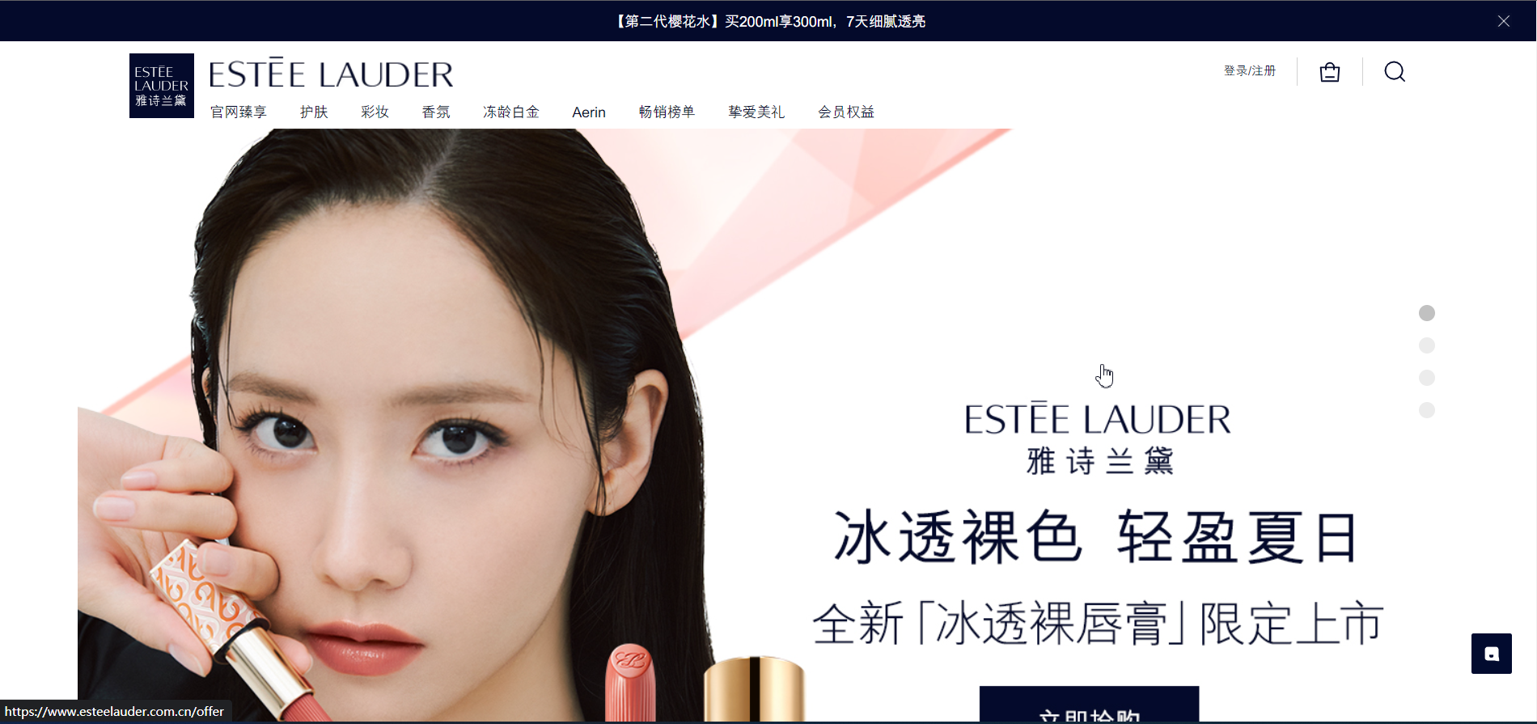
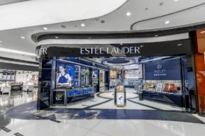




Channel
Sites
Online
shops
Channel are various, including:
Newspaper, Booklet
SMS, Email
Display, SEO, SEM, Affiliate
Office-line Activities
Marketers often make unreasonable marketing budgets with no reference and subjectively.
And from advertising to deal ,they have no approaches to assess the performance of the channels and the creatives and not know how to improve the creatives and adjust channel strategies.
Sites can be online shop and offline stores.
Without data-driven strategies, marketers don’t know how optimize the layout and creative designs.
These elements are impactful visually on customers’ shopping UX which is as important as the products themselves.
Most time, Customers come into site with manys touchs on different creatives. Marketers could not work out the channel attributions which could help adjust marketing strategies.
Offline
stores
Advertising
Touching
Viewing
Dealing
Marketers Dispatch creatives to Channels to attract traffic to online and offline sites.
Customers touch the sites from creatives dispatched in channels
Customers show interest in the brand and products
Customers complete deal when they determined to buy products.

Slide 7
Nowadays Trends
Nowadays Marketer don’t only care about sales data like CRM. They care more about how to use 1st,2nd,3rd data help choose selected audiences and dispatch creative, and care about the relationship between Sales and Site UX, Channel Strategies, Audience, and even Creatives to motivate a smart marketing with data-driven tech.
Therefore, more marketing tools are made for marketers like, Web Analytics Tool for Site UX, DMP for new leads, CDP for repeated marketing and sales.
But there is a lack of a tool or a solution which make creatives design bound with sales performance and in return help markets choose suitable creative team for next marketing activities.

Slide 8
Performance Marketing Lifecycle
Despite of the concepts of Digital Marketing, Precision Marketing or Performance, we can not avoid caring about the importance of these two cycles left graph shows.
Cycle 1 (1-1,1-2,1-3) shows that creatives play a very important role in drive traffic which is determined by creatives’ qualities. It in return assesses the creative teams with data performance from commerce end.
Cycle 2(2-1,2-2) shows that marketing strategies affect the sales performance as well. It assesses the channel strategies which marketers set. And data passed in Marketing Tool can also help improve site layout and UX in return.
(1-1)
Marketing
Creatives
(2-2)
(2-1)
Commerce End
(1-3)
(1-2)

Slide 9
Marketing Cycle Data Flow Phase
Phase I
Phase II
Phase III
Gain Lead
First Deal
Return and Loyalty
Marketers request for creatives from different creatives teams for dispatching to channels.
Integrated Data from CDP, CRM, Web Analytics to DMP, Marketers segment out new potential customers in 3rd party data which has be matched with 1st client Data and 2nd party Data and dispatch creatives to these segment and drive traffic to commerce end.
Usually, DMP connect to SMS, Email, Social Media and even SEM, SEO to deploy the creatives.
When the customers segmented out by markets touched commerce end, some of them will complete their first order.
This phase means that these customers have established the fundamental relationship with brand. And the customer data and order data will be simply passed to CRM system.
Other than Order Data, behavior data and user path, will be passed to Web Analytics Cloud.
Data Mentioned will used for sites UX optimization, customized marketing, A/B Test to enhance the stickiness of return customers.
CRM and Web Analytics data could be integrated in to CDP and reintegrated with DMP to improve user figure precision and drive more precise traffic.
To enhance repeated sale, marketers often use affiliate tool to put on sales info to gain more orders.
To motivate more excellent creatives and win more profits, data will also be passed to creative cloud to assess the quality of the creatives and teams, which helps marketers choose most suitable teams for next marketing activities.
Tezign could dig deep into and focus on

Slide 10
Marketing Cycle Data Flow Chart
Creative Cloud
Marketing Cloud
Commerce Side
Web/App Analytics Cloud
Team A
Creative A
Affiliates/ Partnership Tool
Online Shop
DMP
Creative B
A/B Testing
Apps/Facilities
Creative C
CDP
Offline Stores
……
Channel
Affiliates Network
Team B
Booklet/ Magazine
Creative A
SMS/ Email
CRM System
Creative B
SEO/SEM
Creative C
Display
Social Media

Slide 11
Future Opportunities
Whether Tezign choose to stay in Creative area or dig deeper into a performance marketing will probably determine the scale, the type, and the profit level.

Slide 12
Possible Future of Tezign
A Performance Marketing
All-Chain Solution Provider
Commerce Ends
Experiences & Impressions
Be a Tech Product Co and not just an agency.
Cooperate and contract with more outer creative team and make brand owner have more choices. Tezign could have percentage up for every contract between brand owners and creative team.
Assess the creative teams to enhance the experience of brand owners and keep a stable membership with brand owners. Tezign could gain stable revenue due to the membership.
Potential to be a leader in both Creative Advertising and Performance Marketing areas and gain more chances to organize industry activities.
Products
Creative Cloud
Orders
Tezign already has traffic driving monitor
Campaigns & Activities
Tezign lacks conversion and transaction monitor
As above, Tezign may be a forerunner in connecting creative with experiences & impressions digitally. And this is indeed a little part in DAM. more international cos care about how much value creatives have created in brand popularity, product awareness, sales performance, and campaign performance. I believe that after joining Tezign all these visions could be precisely developed to meet modern customers' requirements and evolve DAM solutions development.

Slide 13
Be a Performance Marketing Automation SaaS Provider
Brand Owner publish a creative request.
Brand Owner filter out several creatives team and launched a sealed bid invitation to wait for creatives team giving design sample, pricing, estimated deadline and etc.
After creatives teams accept bid invitation and complete replying, brand owner contract with the best team according to bid info they gives and even the history performance and assessment before.
After contract signed, creative team complete production and upload workouts to cloud.
If brand owner want to dispatch creatives to channels, he or she could get down a creative file and tracking links which is led to destination sites and put these file and links combined together to channels.
We track the touching data including who touches the ads, the ads creative team, the order info and then process the data to assess the creative team performance in current creative request for the reference in next contract or new brand owner to check and tag the Creative team for easy search.
The platform will take the funds from brand owner temporary and pay to the creative teams after the contract closed .We get percentage up for the platform service from the request contract between creative team and brand owner.
Performance Marketing Cloud
Commerce End
Creative Delivery Interface
Team A
A Site
Creative A
Brand Owner A
Creative B
Creative C
B Site
Score: 4.9
Tag: Simple Style
Brand Owner B
Team B
C Site
Creative A
Creative B
Brand Owner C
Creative C
Creative Data Flow Interface
Score: 4.7
Tag: Chinese Style

Slide 14
Meet With Tezign
THANK YOU
David Ding

